Slide 1
Biomedical Monitoring for Astronauts
Team 310 2/9/2024

Slide 2
Table of Contents
Team Introductions
Summary of Project
Current Prototype State
Sensor Integration Progress
PCB Design Progress
Spring Work Breakdown Structure

Slide 3
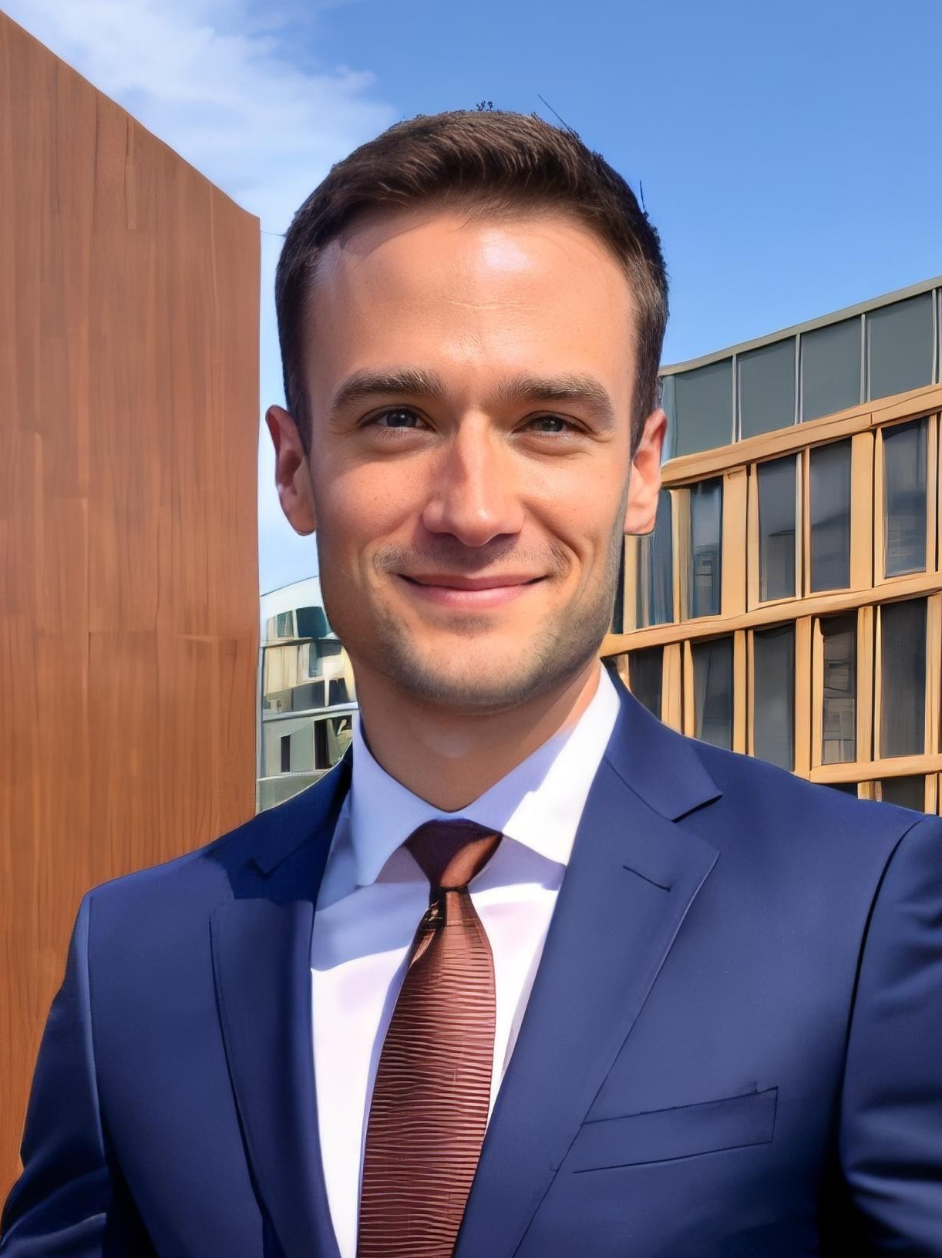
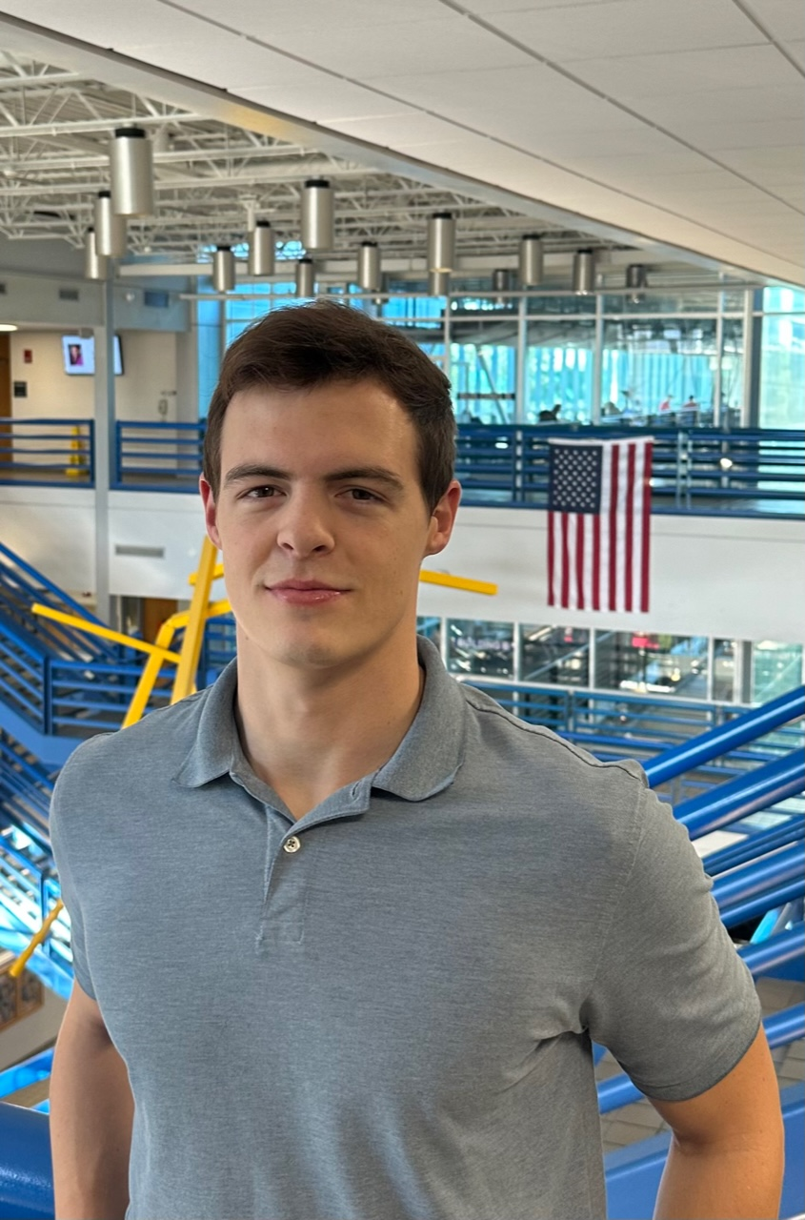
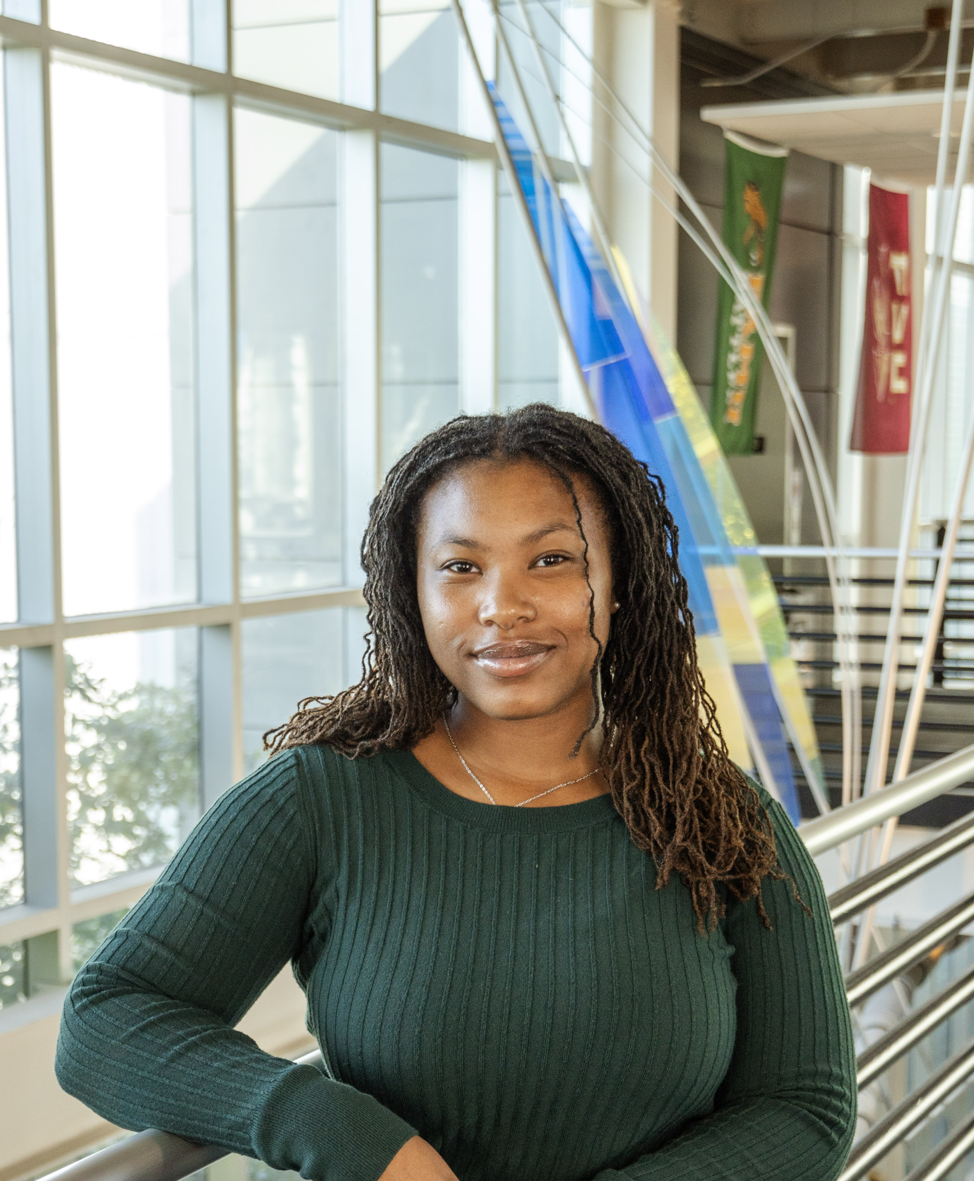
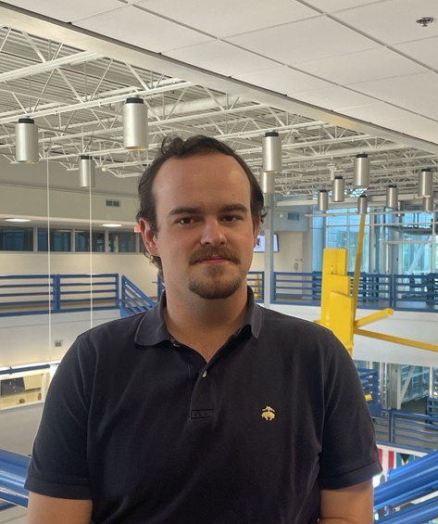
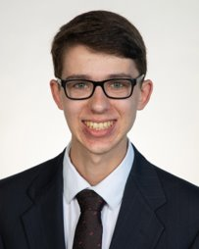

Team Introductions
Evan Cloutier
Project Manager
Nick Billmire
Digital Communication Engineer
Jada Davis
Software Engineer
Landon Hicks
PCB Design Engineer
Austin Roberts
Signal Processing Engineer
Dallas Toth Test Engineer

Slide 4
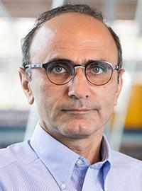
Sponsor and Advisors
Sponsor
L3Harris Technologies
Faculty Advisor
Babak Noroozi, Ph.D.
Professor

Slide 5
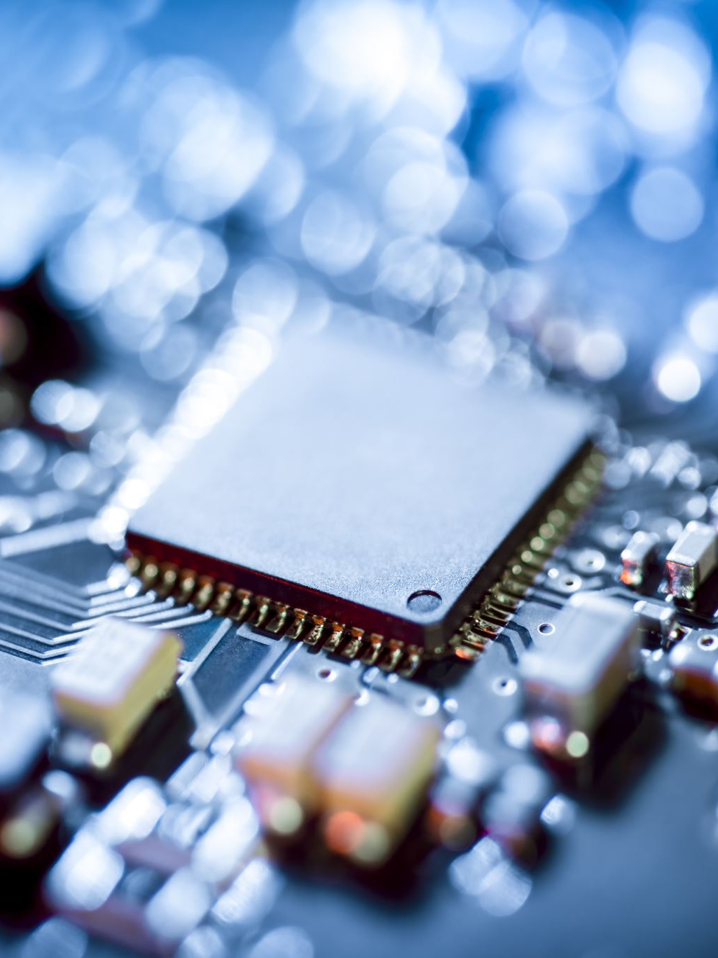
Original L3Harris Project Description
Multi-Axial Angular Sensor:​
A form/fit/function replacement​
Design a circuit card assembly for a provided sensor​
Develop code needed to output the proper message format ​
Construct the card within given size limitations​
Regulate power to the sensor​
Output in RS-422 message format

Slide 6
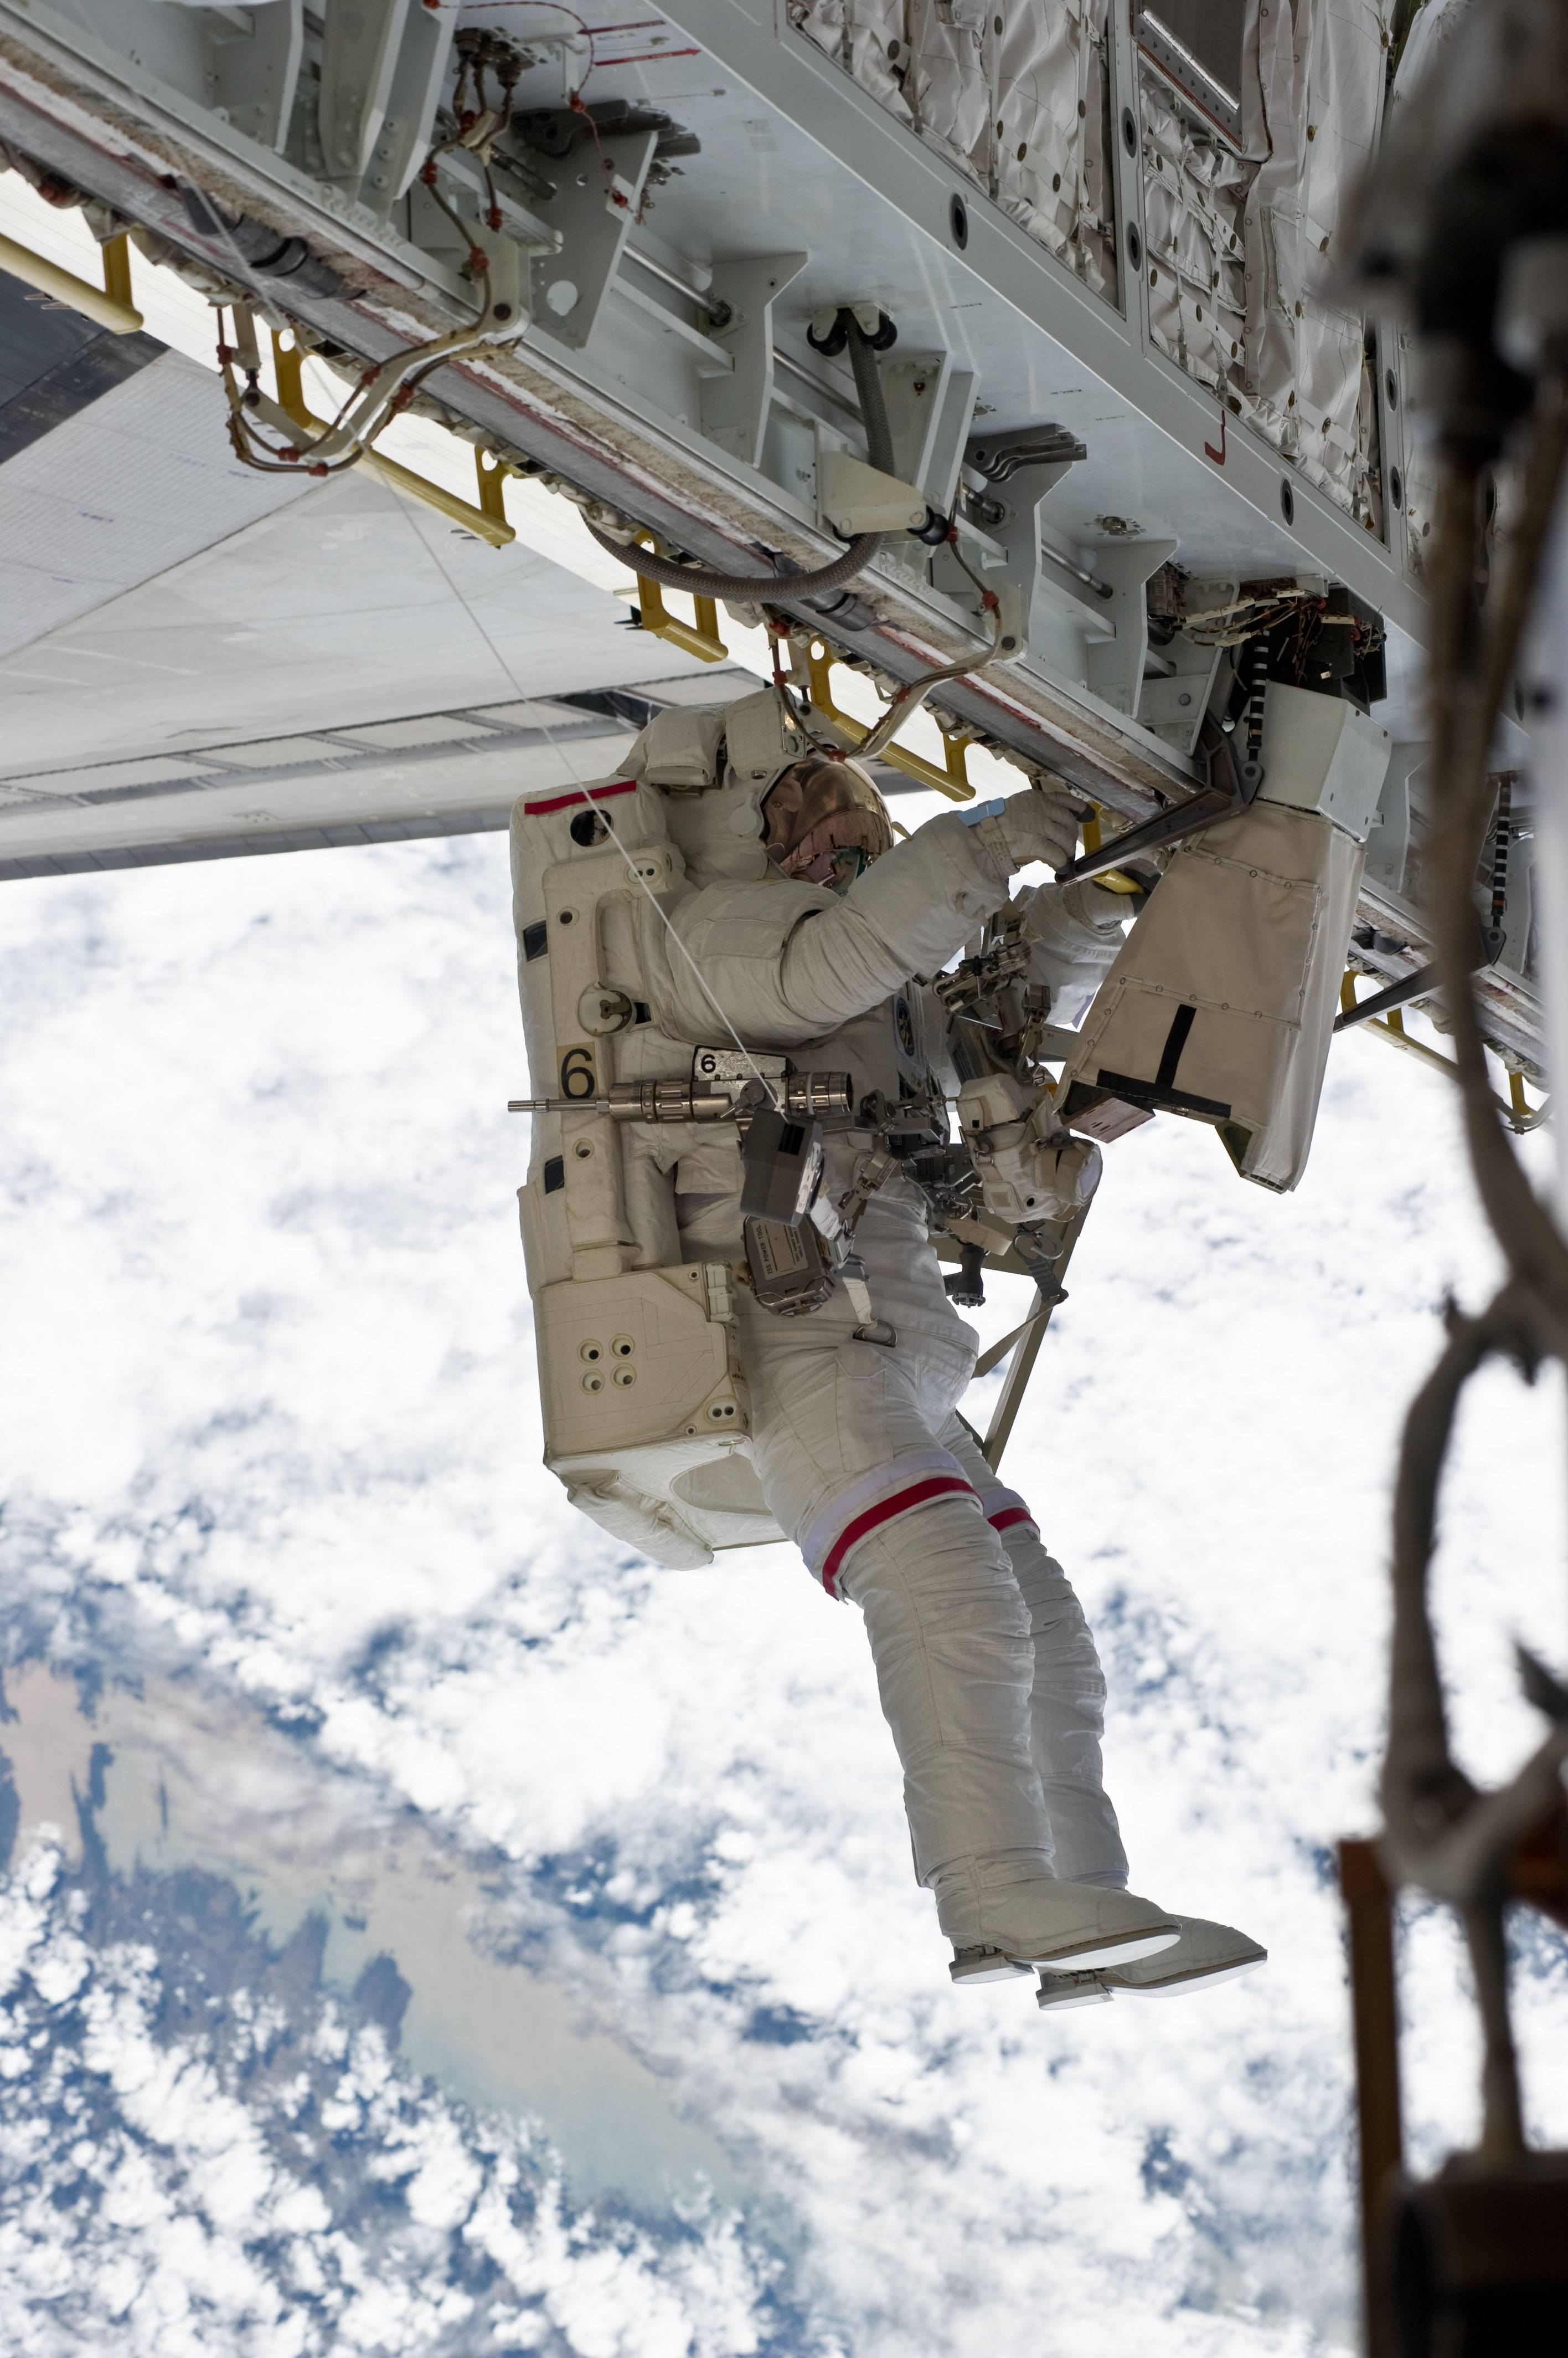
Summary of Current Project Description
Sensor package capable of monitoring an astronaut’s vital signs and spacesuit environment during extravehicular activity (EVA)
Transmit sensor data to the main communications system via a serial interface
Detect abnormal readings and trigger appropriate alarms

Slide 7
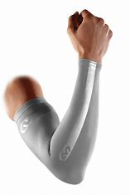
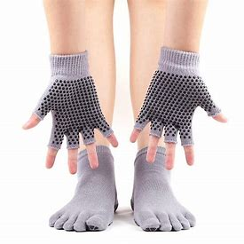
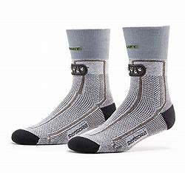
Concept Selection
Concept 1
Concept 2
Concept 3
Internal wearable arm sleeve and an external device.
Set of gloves and socks equipped with RFID communicate data to a PCB with an MCU & memory.
Wearable sock with heart rate sensor, on-toe pulse oximeter, thermometer, and GSR.

Slide 8
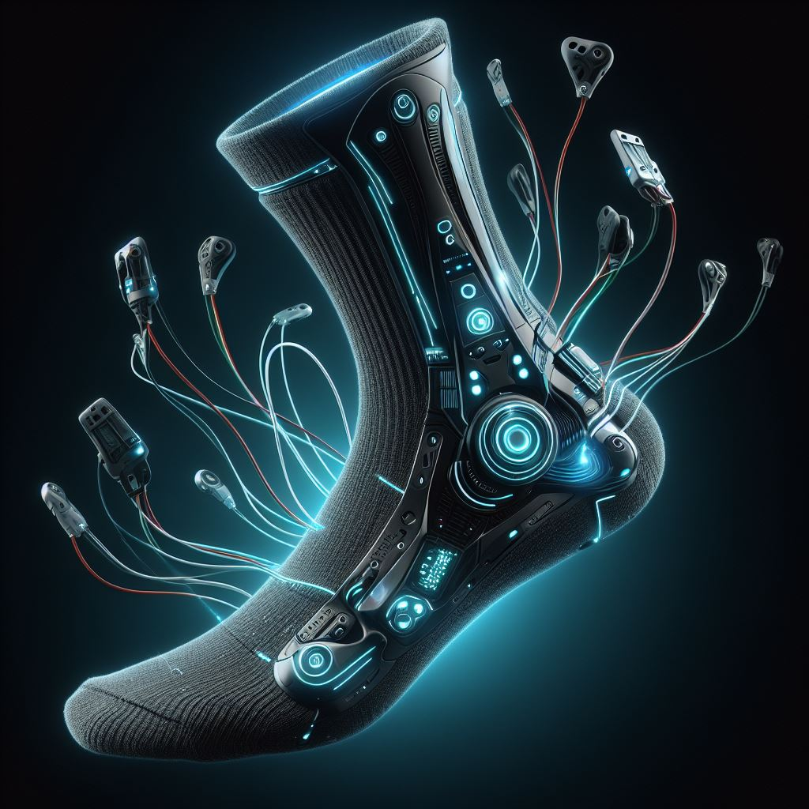
Selected Design
Sensing Sock and Environment Sensor Package
Wearable sock
Heart rate sensor
Pulse oximeter
Thermometer
Galvanic skin response sensor
External to the sock: spacesuit environment sensors
CO2
Pressure
Temperature/Humidity
Artistic rendering only; not an actual depiction.

Slide 9
Selected Design
Design Choice Justification
Performed exceptionally well against comparison criteria
Feasible to implement while containing certain manageably challenging aspects
Fitting biomedical sensors into a textile for the foot
Adequately logging and transmitting sensor data
Presents similar engineering challenges to the original project while resolving its deficiencies
Artistic rendering only; not an actual depiction.

Slide 10
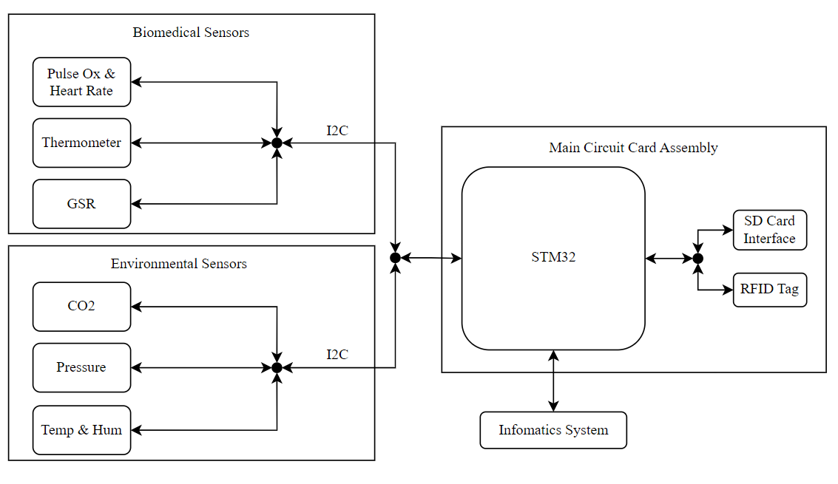
Detailed Design Block Diagram

Slide 11
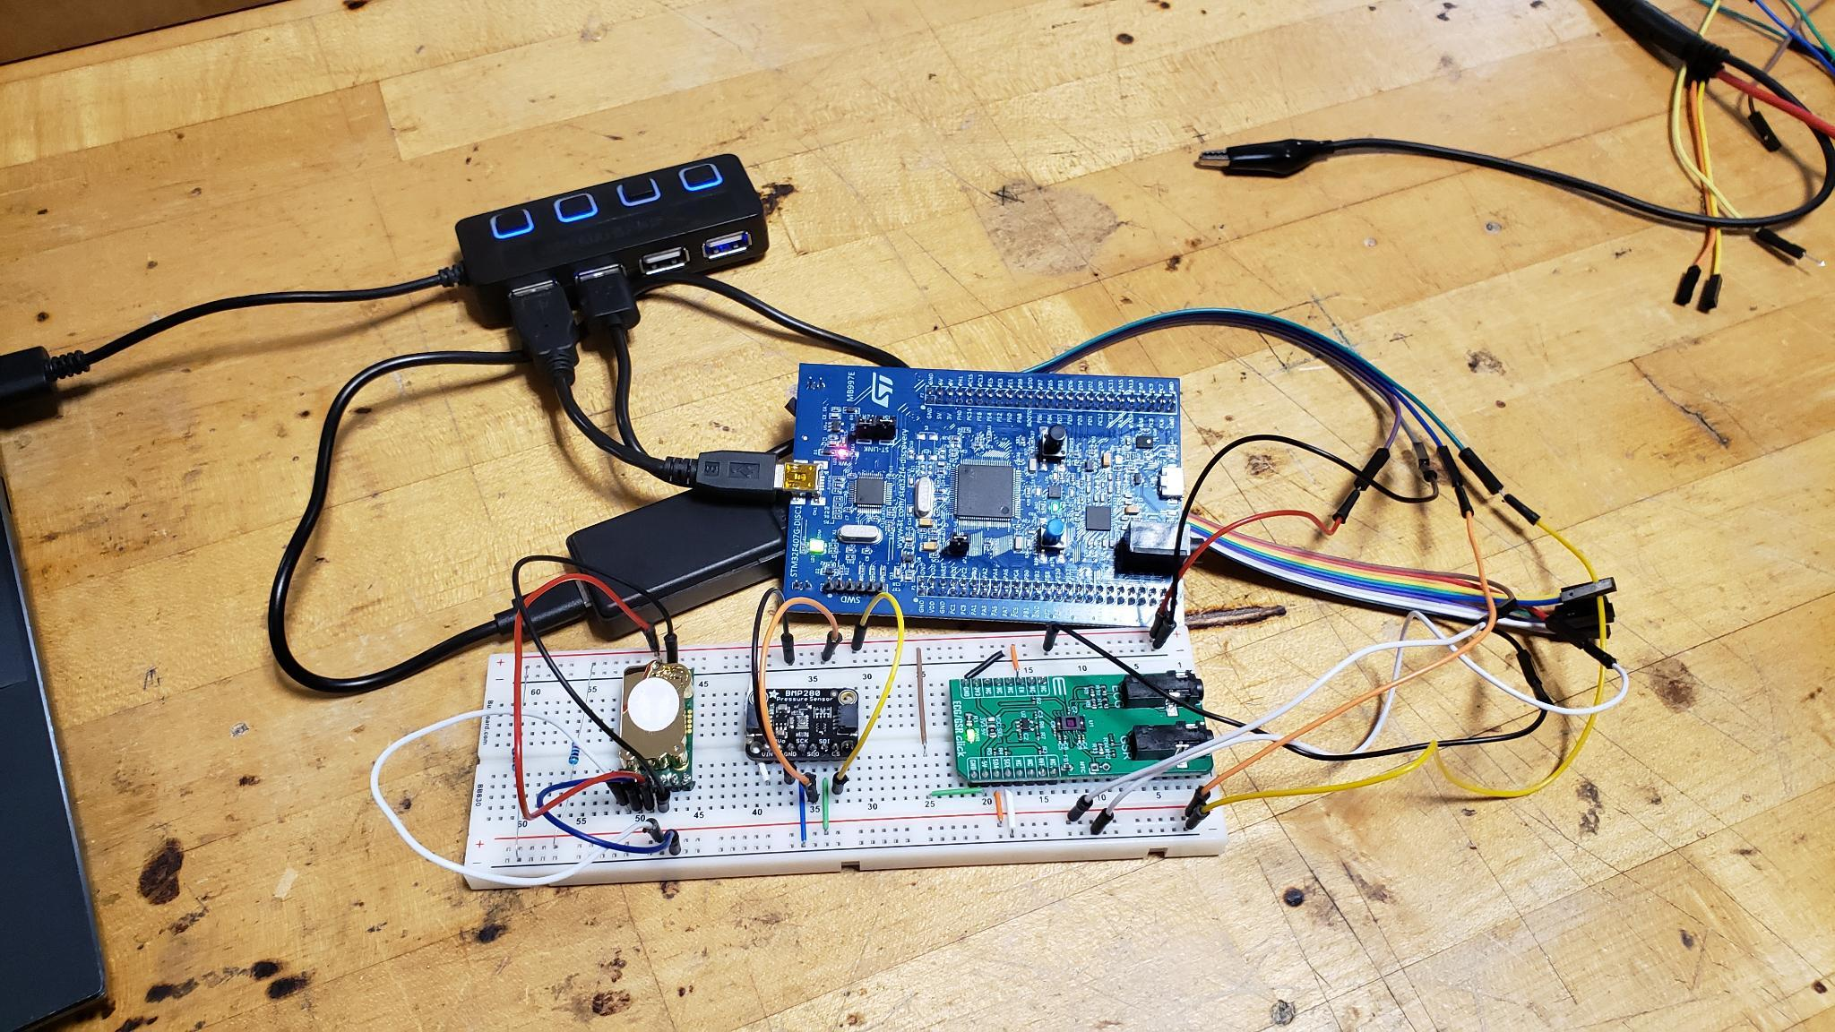
Current Prototype State
Notes:
Photo of the breadboard with sensors on it here. Explain the connections without going into detail about software or each sensor’s specs

Slide 12
Sensor Integration Progress
Biomedical Sensor Board
Notes:
Focus in on each sensor, spend most of the time on the biomedical sensor, end by explaining connections and progress. How did we establish or will we establish communication?

Slide 13
Sensor Integration Progress
Pressure Sensor
Notes:
Focus in on each sensor, spend most of the time on the biomedical sensor, end by explaining connections and progress. How did we establish or will we establish communication?

Slide 14
Sensor Integration Progress
CO2 Sensor
Notes:
Focus in on each sensor, spend most of the time on the biomedical sensor, end by explaining connections and progress. How did we establish or will we establish communication?

Slide 15
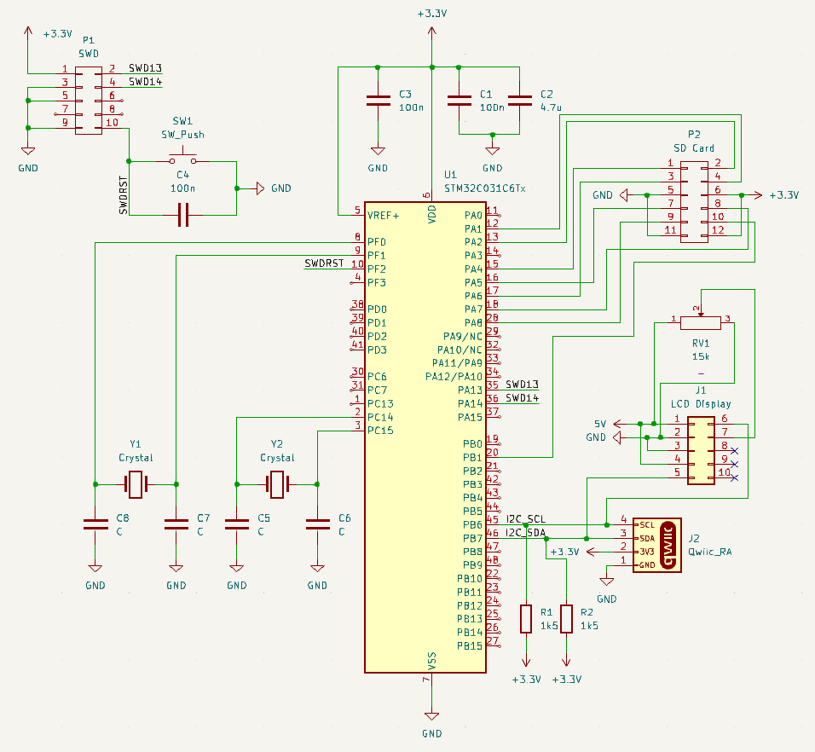
PCB Design
Notes:
Include where we will order the PCB from, or if it will be made by Hooker
Mention how many layers the PCB will have, also pricing if available, and justify these.
Consider how to assemble the PCB, especially how to connect middle layers to the pin (not needed for the presentation, but important to think about).

Slide 16
Spring Work Breakdown Structure
Tasks | Description | Assigned to | Progress | Start | Due Date
Updated BOM | Include additional items needed to the BOM and send to Dr. Hooker for purchasing. | Evan Cloutier, Austin Roberts | 100% | 1/8/2024 | 1/15/2024
Abstract | Create an abstract discussing motivations and goals of the project | Evan Cloutier, Austin Roberts | 100% | 1/22/2024 | 2/2/2024
VDR 4 | Update of Fall progress & future work. | All | 99% | 1/22/2024 | 2/9/2024
PCB Design & Ordering | Design a PCB that can house all sensors and connections. | Landon Hicks, Nicholas Billmire | 25% | 2/5/2024 | 2/22/2024
VDR 5 | Initial prototype presentation | All | 0% | 2/12/2024 | ~3 weeks
Interfacing sensors with MCU | Create an initial prototype of sensor connections and gather data. | Austin Roberts, Jada Davis | 20% | 2/1/2024 | 3/1/2024
Software design | Write the software for our design and format parameters like threshold values, alarms, and display values. | Jada Davis | 0% | 2/12/2024 | 3/1/2024
Testing Documentation | Create testing documentation. This will enable efficient and thorough testing of our design. | Dallas Toth, Evan Cloutier | 0% | 2/19/2024 | 3/1/2024
Integrate sensors in the sock | Synthesize the final, wearable design as described in our scope. | Landon Hicks | 0% | ? | ?
Begin Testing Procedures | Complete testing procedures per standards given in the documentation. | Dallas Toth, Evan Cloutier | 0% | 3/1/2024 | ?
Create Website | Create website to demonstrate our project | Evan Cloutier | 20% | 2/1/24 | ?
Final Presentation | Prepare and present a final product that solves our problem. | All | 0% | After VDR 5 | ?
Final Demonstration | Provide a technical demonstration of our design to faculty involved in the project. This will be the last thing that we do. | All | 0% | ? | ?
Notes:
- Introduce WBS
- first few are completed
- next few are actively being worked on
-

Slide 17
Questions?

Slide 18
Backup Slides

Slide 20
Slide Headline
Try to keep text at 16 pt minimum.

Slide 21
Slide Headline
Try to keep text at 16 pt minimum.
Try to put as few words as possible on the slide if you’re using for a presentation.

Slide 22
Slide Headline
Try to keep text at 16 pt minimum.
Try to put as few words as possible on the slide if you’re using for a presentation.
Mix and match the backgrounds as shown in this template or just use one throughout.

Slide 23





Slide Headline
Try to keep text at 16 pt minimum.
Try to put as few words as possible on the slide if you’re using for a presentation.
Mix and match the backgrounds as shown in this template or just use one throughout.
You can put department/unit logos in slide master at Horizontal 0.89” Vertical 6.44” From top left corner

Slide 24
This is 10-point
This is 15–point Times
This is 20–point
This is 25–point
This is 30–point
This is 35–point
This is 40–point
This is 50–point
This is 60–point
This is 72–point
Notes:
Use at least 20-point font in Room A105, B134, and B136
Use at least 25-point font in Room B135

Slide 25
College of Engineering Color Palette
1 2 3 4
Pantone: PMS 195 C
RGB: 120, 47, 64
Hex: #782F40
CMYK:19, 90, 50, 55
1 2 3 4
Pantone: Black C
RGB: 0, 0, 0
Hex: #000000
CMYK:0, 0, 0, 100
Garnet
Black
1 2 3 4
RGB: 238, 118, 36
Hex: #EE7624
CMYK:2, 66, 99, 0
1 2 3 4
Pantone: PMS 000C
RGB: 255, 255, 255
Hex: #FFFFFF
CMYK: 0, 0, 0, 0
Fang
Orange
White
Notes:
Avoid 75% Black in B135

Slide 26
Accent Color Palette
1 2 3 4
RGB: 0, 59, 111
Hex: #003B6F
CMYK:
1 2 3 4
RGB: 0, 59, 111
Hex: #003B6F
CMYK:
1 2 3 4
RGB: 251, 236, 93
Hex: #FBEC5D
CMYK:
1 2 3 4
RGB: 219, 215, 210
Hex: #DBD7D2
CMYK:
1 2 3 4
RGB: 251, 236, 93
Hex: #FBEC5D
CMYK:
1 2 3 4
RGB: 219, 215, 210
Hex: #DBD7D2
CMYK:
Tardis Blue
Tardis Blue
Corn
Timberwolf
Corn
Timberwolf
1 2 3 4
RGB: 206, 0, 88
Hex: #CE0058
CMYK: 0, 100, 43, 12
1 2 3 4
RGB: 206, 0, 88
Hex: #CE0058
CMYK: 0, 100, 43, 12
1 2 3 4
RGB: 104, 40, 96
Hex: #682860
CMYK:
1 2 3 4
RGB: 220, 220, 220
Hex: #DCDCDC
CMYK:
Rubine Red
Rubine Red
Imperial
Gainsboro
1 2 3 4
RGB: 72, 146, 155
Hex: #48929b
CMYK:
1 2 3 4
RGB: 64, 224, 208
Hex: #40E0D0
CMYK:
1 2 3 4
RGB: 255, 139, 0
Hex: #FF8B00
CMYK:
Asagi-iro
Turquoise
American Orange
Notes:
Remove American orange add hyperlink grey
Make corn the last for b135
All work in 134 imperial move later
Tardis doesn’t work in b136

Slide 27
F7AB19
D67F15
EE7624
D64615
F73119
Analogous
https://color.adobe.com/create/color-wheel
6E3610
F0A16C
EE7624
6E4931
BASB1C
Monochromatic
A14508
4BED3B
EE7624
250CED
2010A1
Triad
A1470C
FF8C40
EE7624
0098A1
24E2ED
Complementary
28A164
2FED8D
EE7624
0848A1
1871ED
Split Complementary
EDAC2F
3BED93
EE7624
0C6AED
ED2F18
Double Split Complementary
ED660C
C7ED3B
EE7624
0CE1ED
A418ED
Square
BA7E09
87724A
EE7624
60EFCF
09BA61
Compound
AD551A
6E3610
EE7624
FA7625
D46820
Shades
Notes:
These are the variants that work well with Fang Orange. The bolded items show well on the projectors.

Slide 28
85412D
8F3831
782f40
8F3176
792D85
Analogous
https://color.adobe.com/create/color-wheel
C44D69
8E626D
782F40
C48796
451B25
Monochromatic
C43959
78743B
782F40
236178
43A2C4
Triad
C43959
C46078
782F40
25C43D
2F783A
Complementary
93C460
577835
782F40
39C49D
297861
Split Complementary
784435
5A783B
782F40
237860
6E2978
Double Split Complementary
782337
78683b
782F40
237830
293978
Square
AB4D32
DEBAAF
782F40
5D8555
70AB32
Compound
38161E
C44D69
782F40
853447
5E2532
Shades

Slide 29
A105
A105
B135 Stage Left
B135 Stage Right
B136
B134, A105
B135

